Slide 1
Southgate Square Special Meeting
June 25, 2019

Slide 2
Neighborhood Summary
178 Townhomes
332 Parking Spaces (2 currently flooded and need repair)
Current reserve fund balance, ~$117,000
Recurring Expenses
  Landscaping - $28,500 (basic services, no storm cleanup, etc.)
  Tree trimming/removal - YTD $11,650
    Upcoming $7,580 of additional work
  Gates Hudson Management - $20,200
Upcoming projects (per reserve study)
  Retaining wall, ~$38,000 - $42,000
  Repair two parking spots, $9,500
  Tot lot maintenance, Estimate Pending
  Concrete, $52,927
  Pavement replacement, ~$150,000 - $200,000

Slide 3
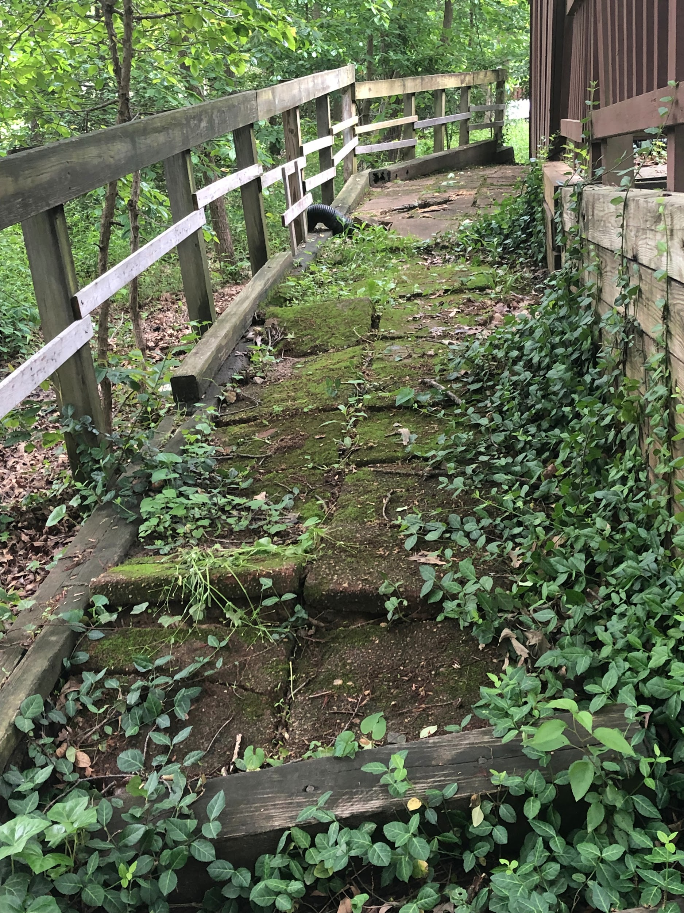
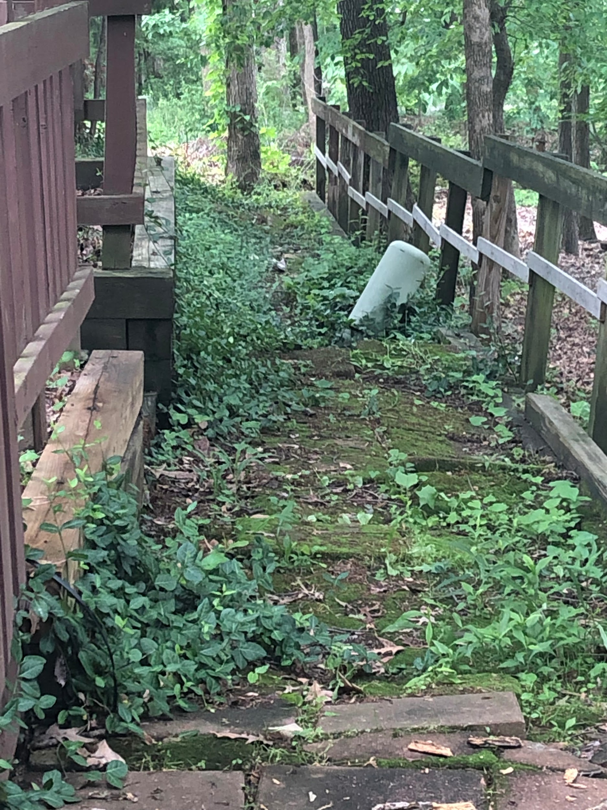
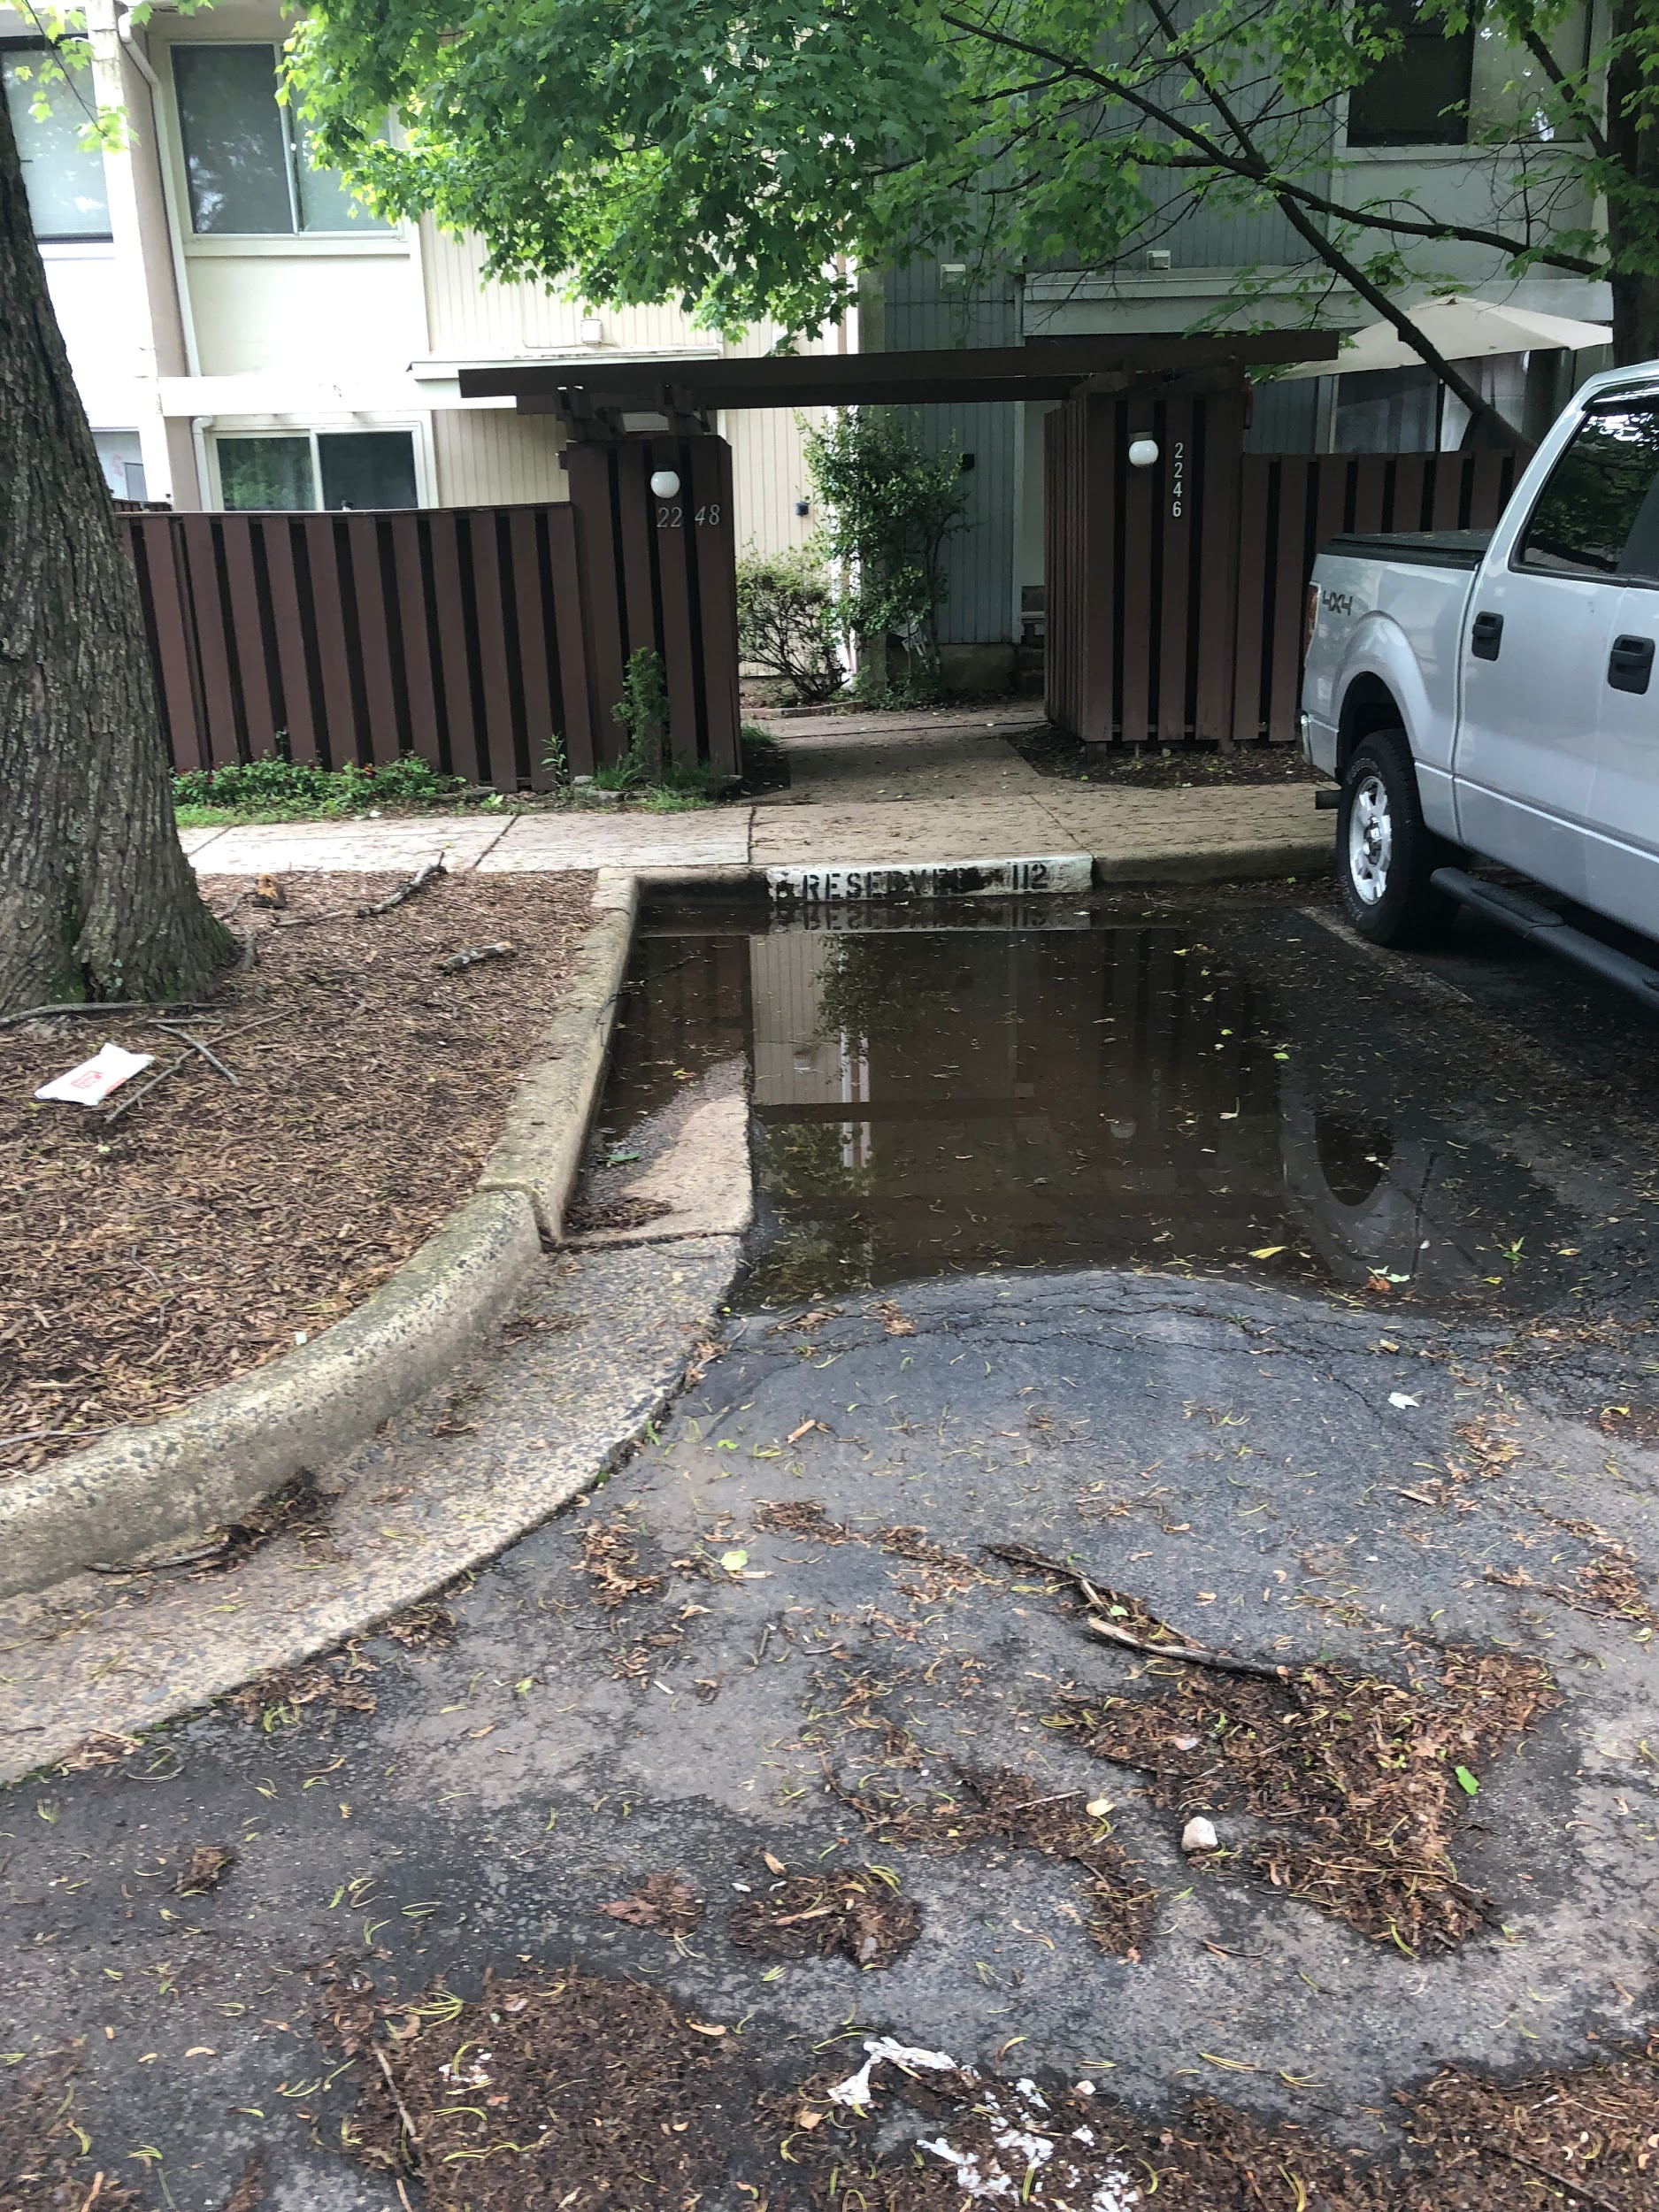
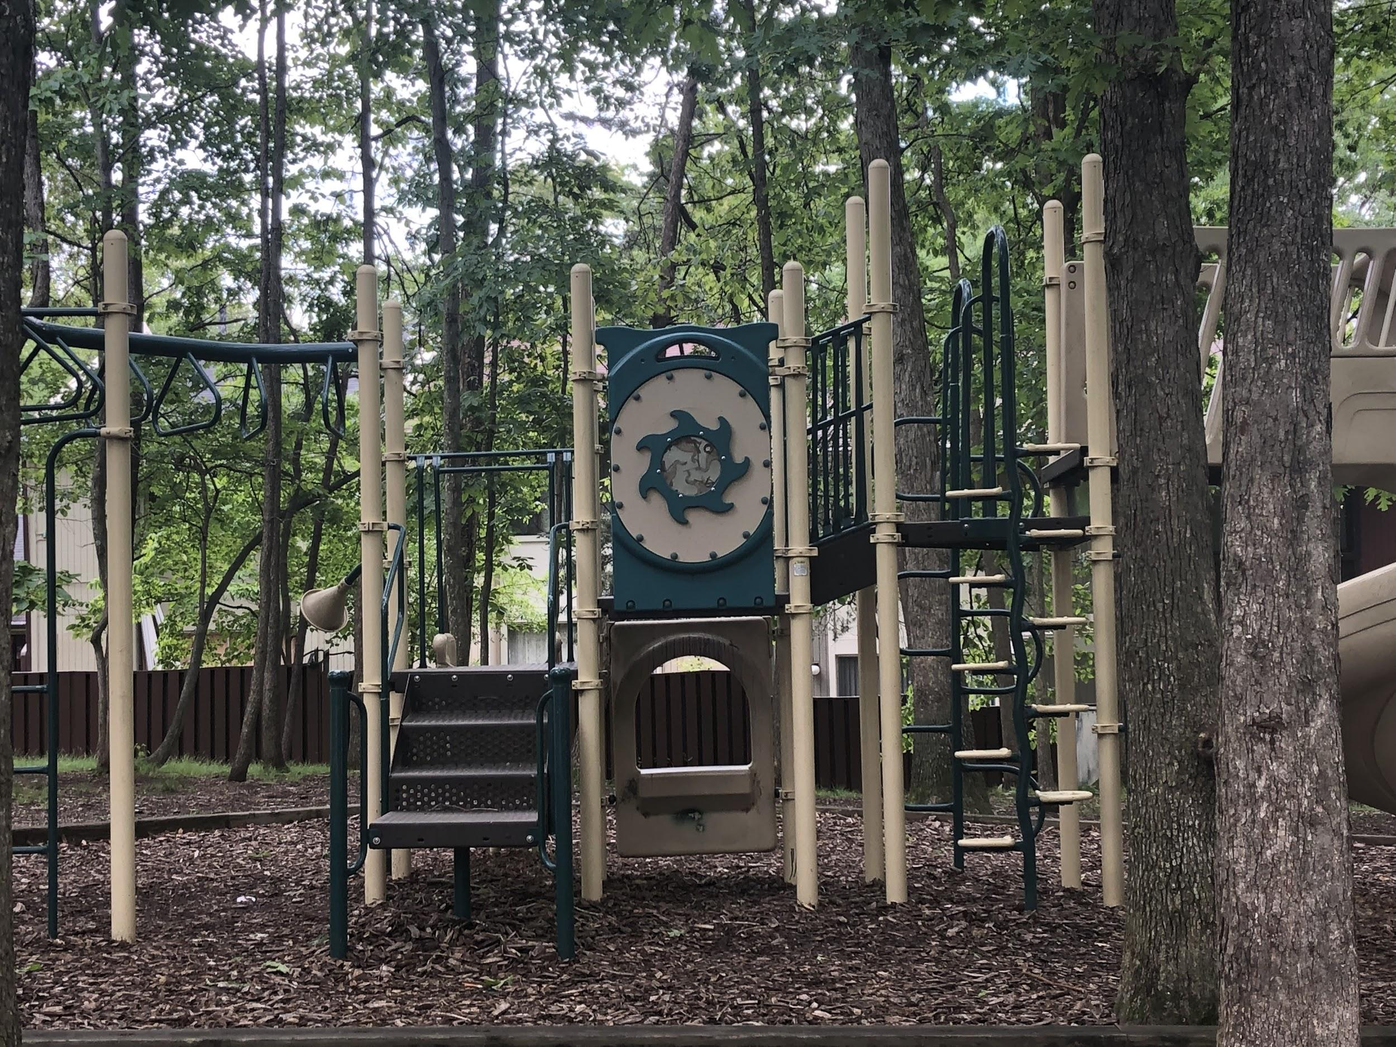
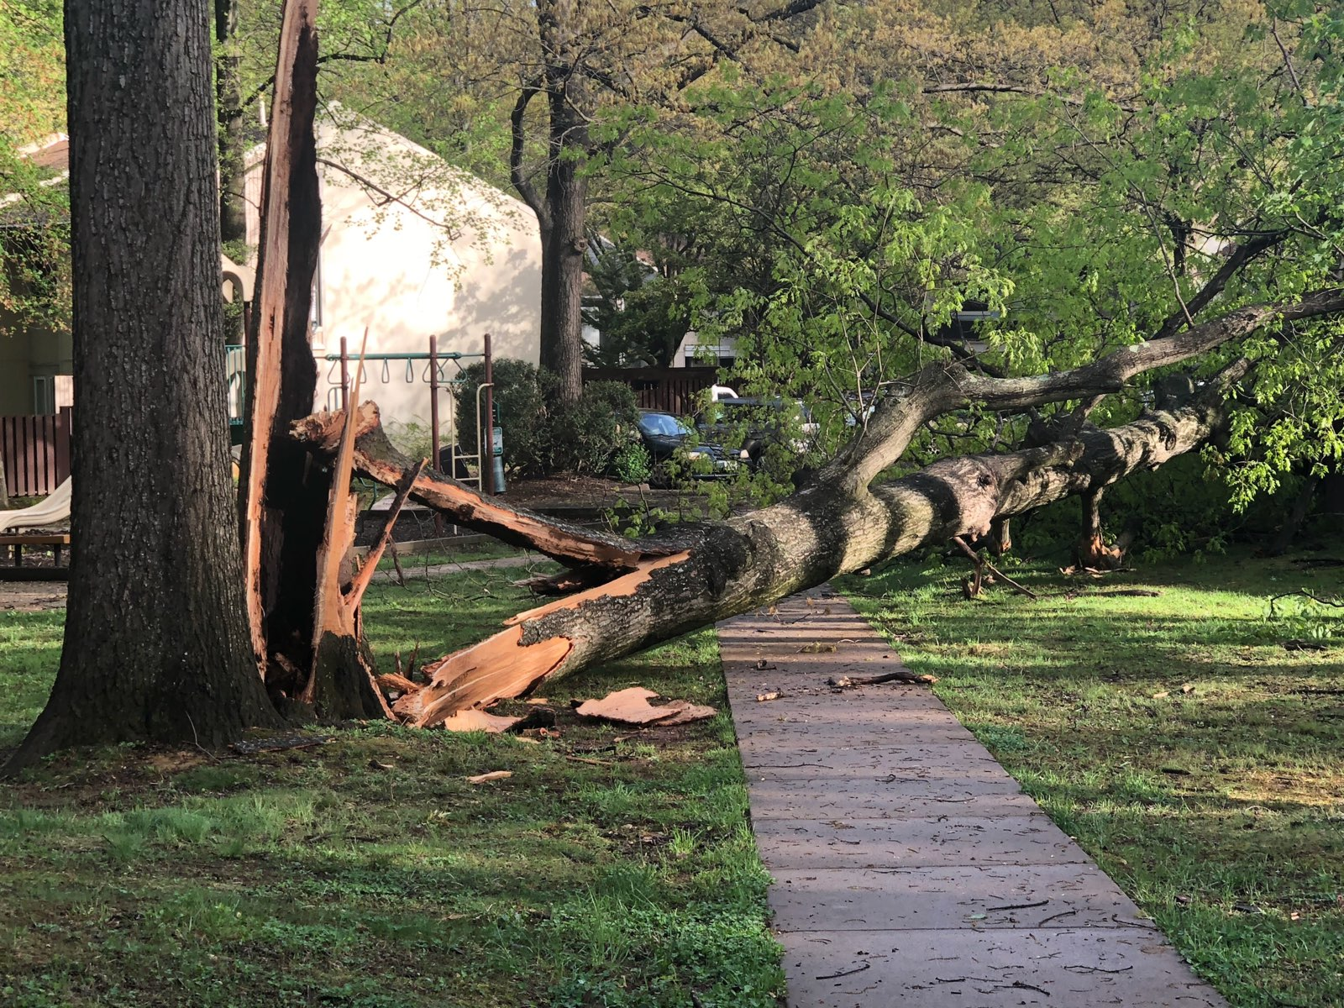

Slide 4
2019 Reserve Study
Foreword - “This report contains information the Board requires to fulfill its fiduciary responsibilities with respect to the financial health of the Association. Even if you are already familiar with the concepts of capital reserve planning, it requires some study. The information in this report is vital to your Association’s financial health. Unless you understand it, your Association may not follow it. This may lead to underfunding and financial stress at some time in the future.”
“Financially, the Association requires a major increase in contributions to reserves as they have not been following the previous plan and in fact, lowered the contribution in the interim. We have stepped the increases over five years to minimize the impact on individual homeowners but have established a sufficient contribution schedule to eventually achieve the fully funded goal by the end of the 20-year period.”
View 2019 Reserve Study

Slide 5
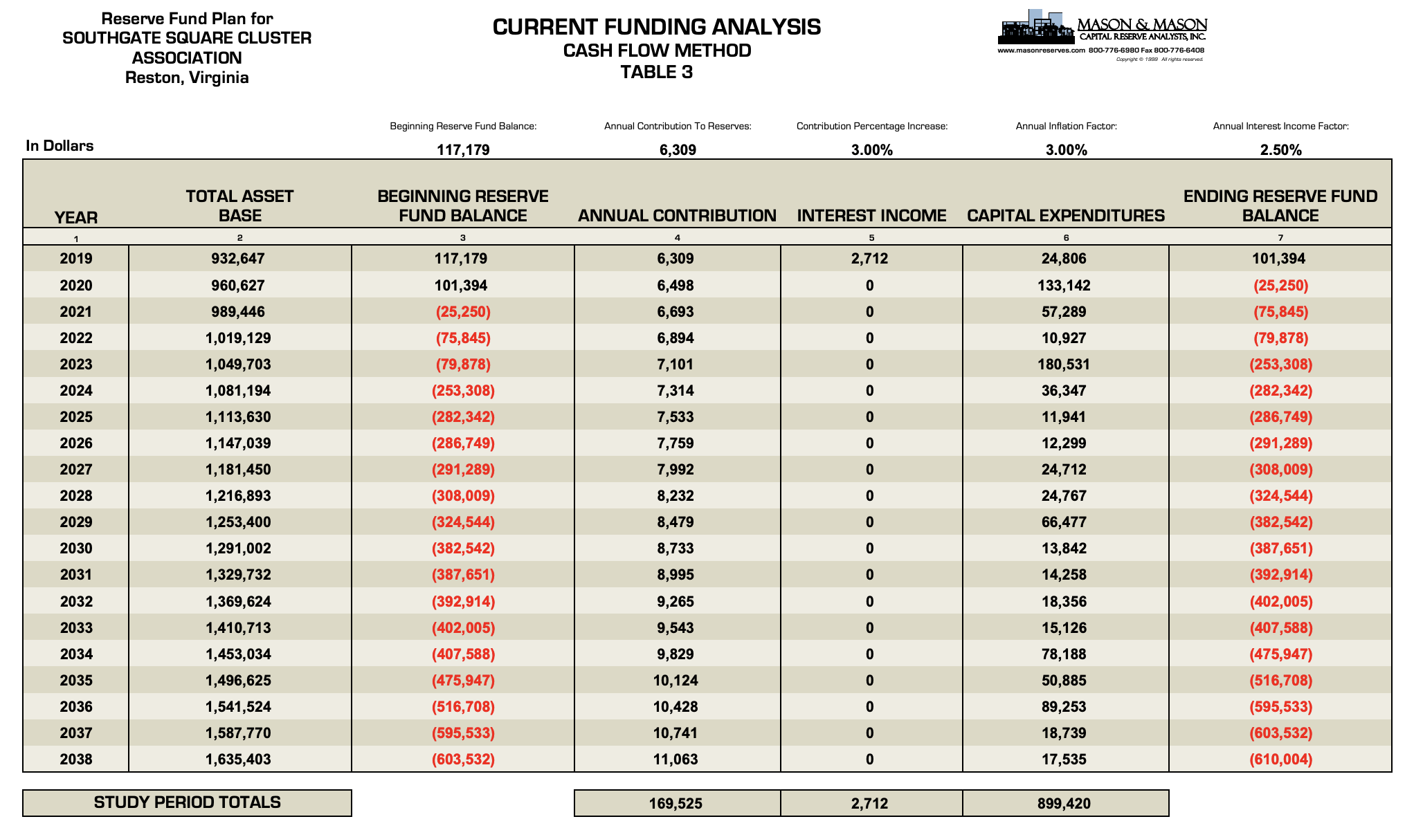

Slide 6
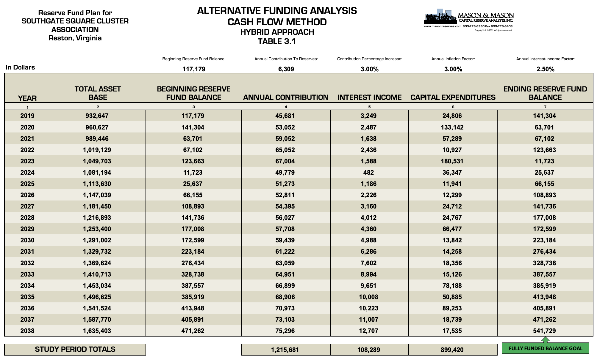

Slide 7
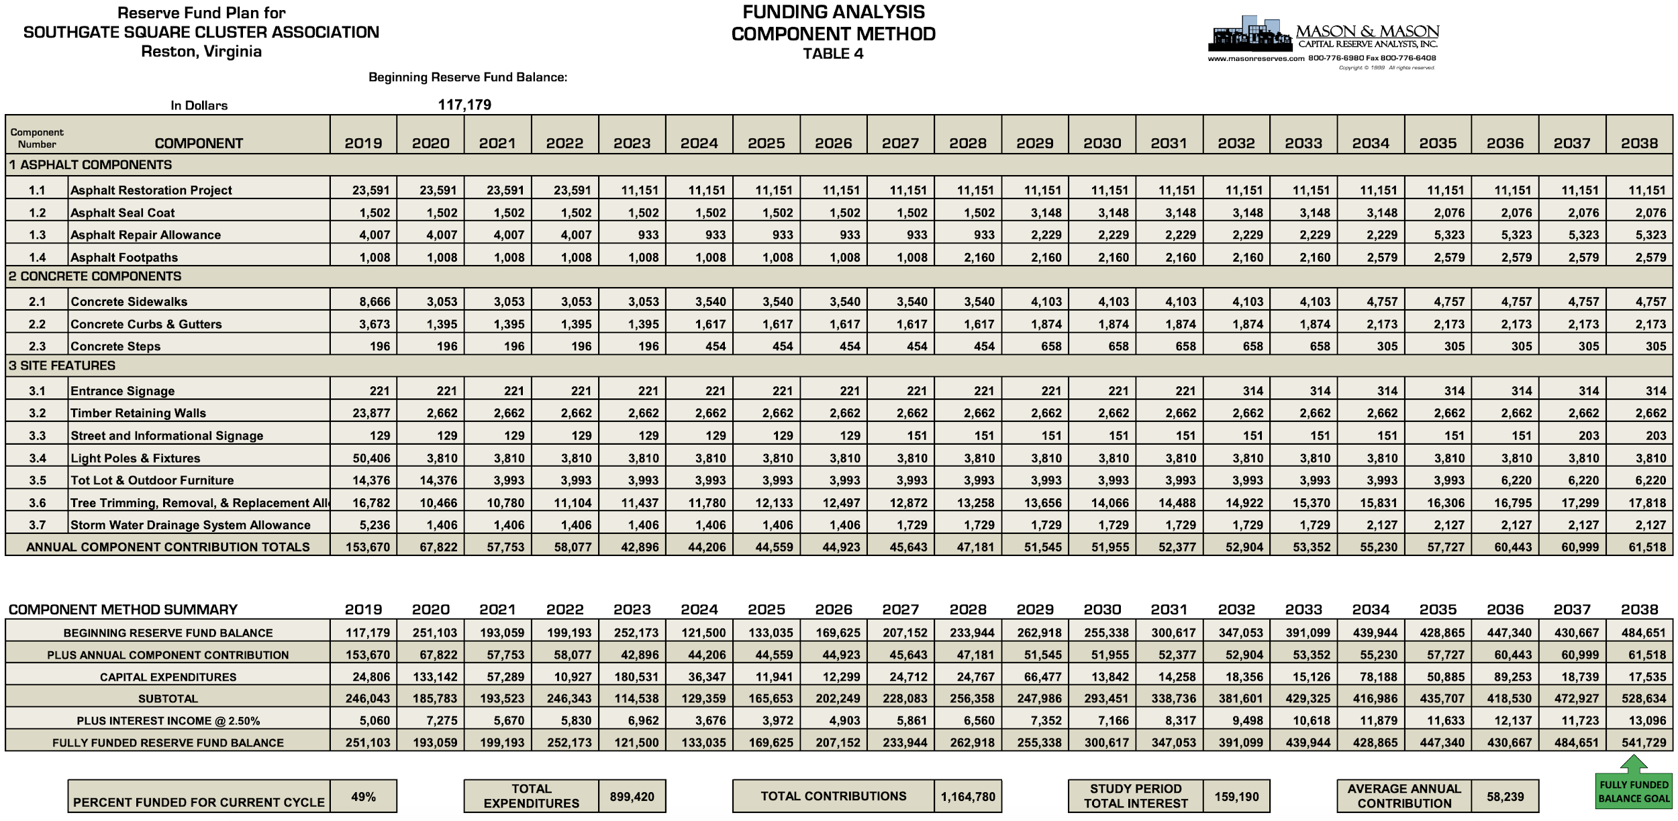

Slide 8
Reserve Study History and Current Reality
If we followed the 2013 Reserve Study increased dues by $11/month and put all into reserve fund, we would not require such a drastic increase today. We (the community) did not do this - instead we lowered the savings contributions and now we need to catch up and plan for the communities future financial health.
The 2007 Reserve study recommended we raise dues by a minimum of $30.68/month to place additional money into reserves - again we ignored the study.
Link to VA law requiring reserve study every 5 years and why:
  https://law.lis.virginia.gov/vacode/title55/chapter26/section55-514.1/
Fanny, Freddie, FHA, VA all require reserve fund to be sufficiently funded in order to buy in our community because we maintain the road (right of easement), and they have certain requirements in order to buy in our community. Attracting and maintaining new, young families will add value to our neighborhood!

Slide 9
Communication Resources
Cluster website - https://www.southgatesquare.com
  Notifications
  Design standards
  Contact form
  And more!
Nextdoor - https://nextdoor.com/neighborhood/southgatereston--reston--va

